Slide 1


Internship Summary

Slide 2
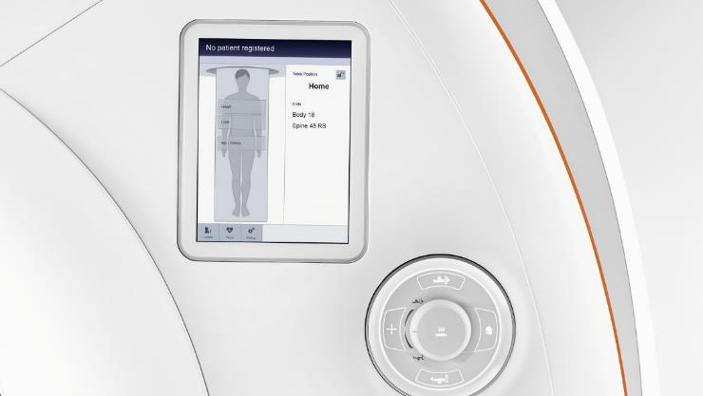
Table of Contents
What’s been done 3
Encountered problems & how they were solved 6

Slide 3
Intern Summary
What’s been done

Slide 4
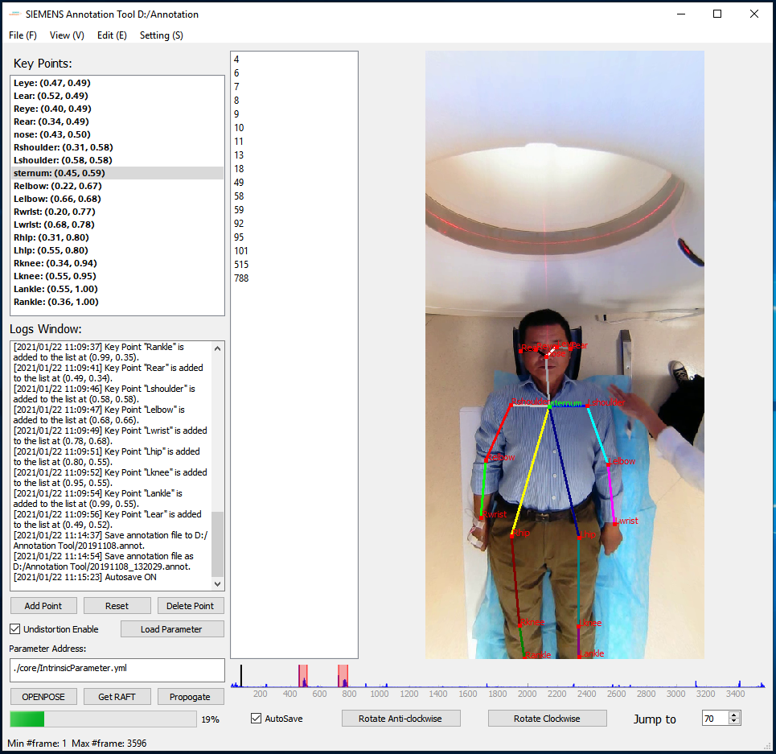
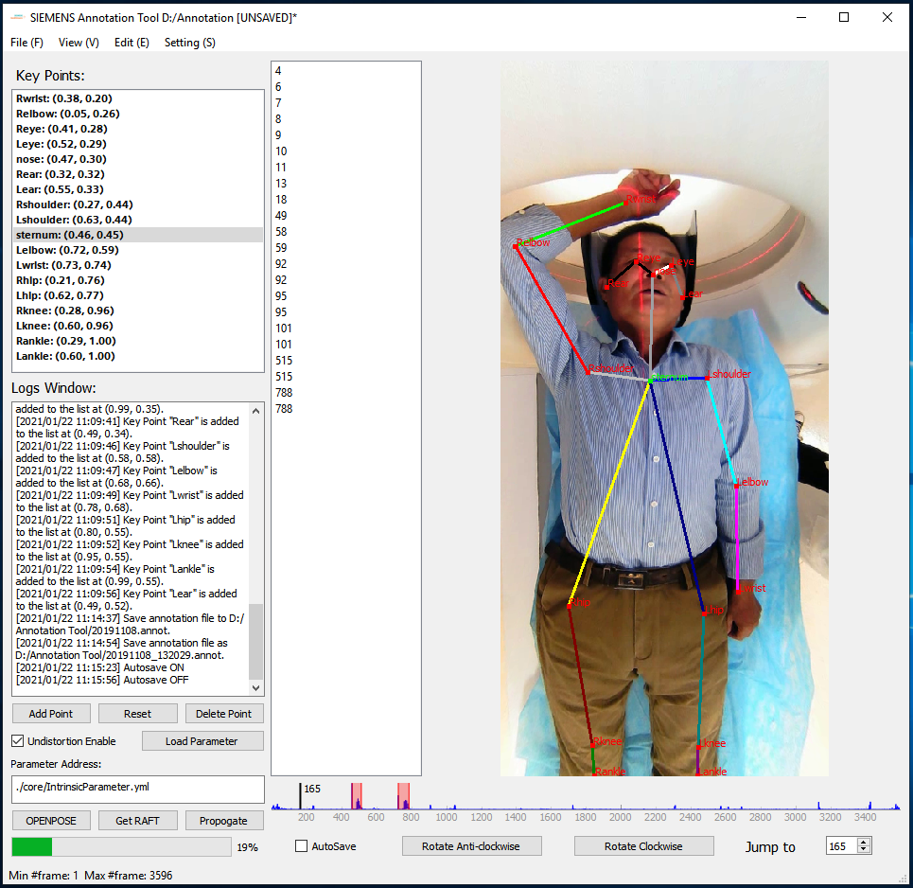
What’s been done
Main Task: Annotation Tool

Slide 5
What’s been done
Work Flow:
Intensity CSV Server
1
Server pre-compute RAFT result matrices, stored in *.avi form
0
RAFT Server
Load CSV file locally or requests from server. Calculate over-exposure region is filter them out
Video Clips
5
Real time calculation if NULL result (set to NULL for overflow frames under int8 dtype)
Client
RAFT Result
3
Client request RAFT result by video clips’ filename as id/key
2
Client request Openpose KeyPoints for one frame
4
Move/ edit keypoints according to RAFT results
Openpose Server

Slide 6
Intern Summary
Encountered Problems & how they were solved

Slide 7
Encountered Problems
Inaccuracy in extreme local movement scenario
Inaccuracy in over-exposure scenario
Unfeasible file size of optical flow result
Lost view of key points
Special scenarios

Slide 8
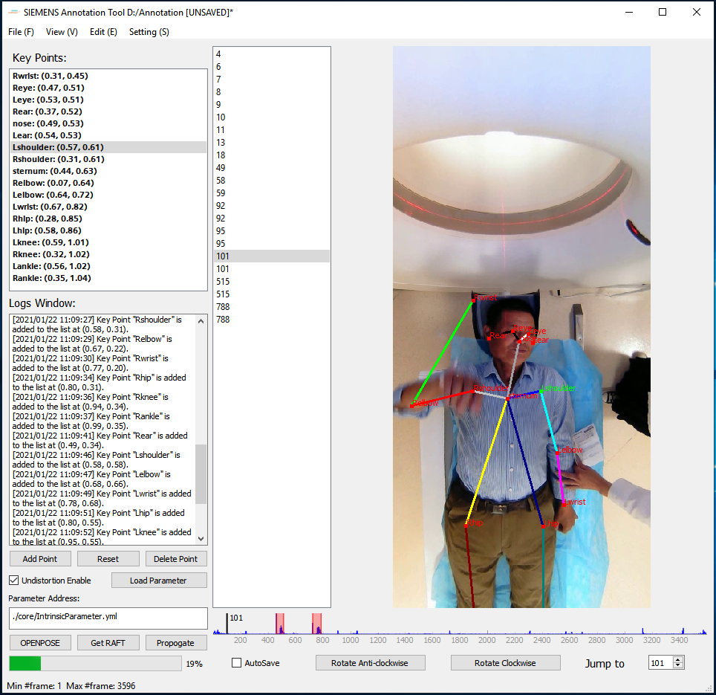
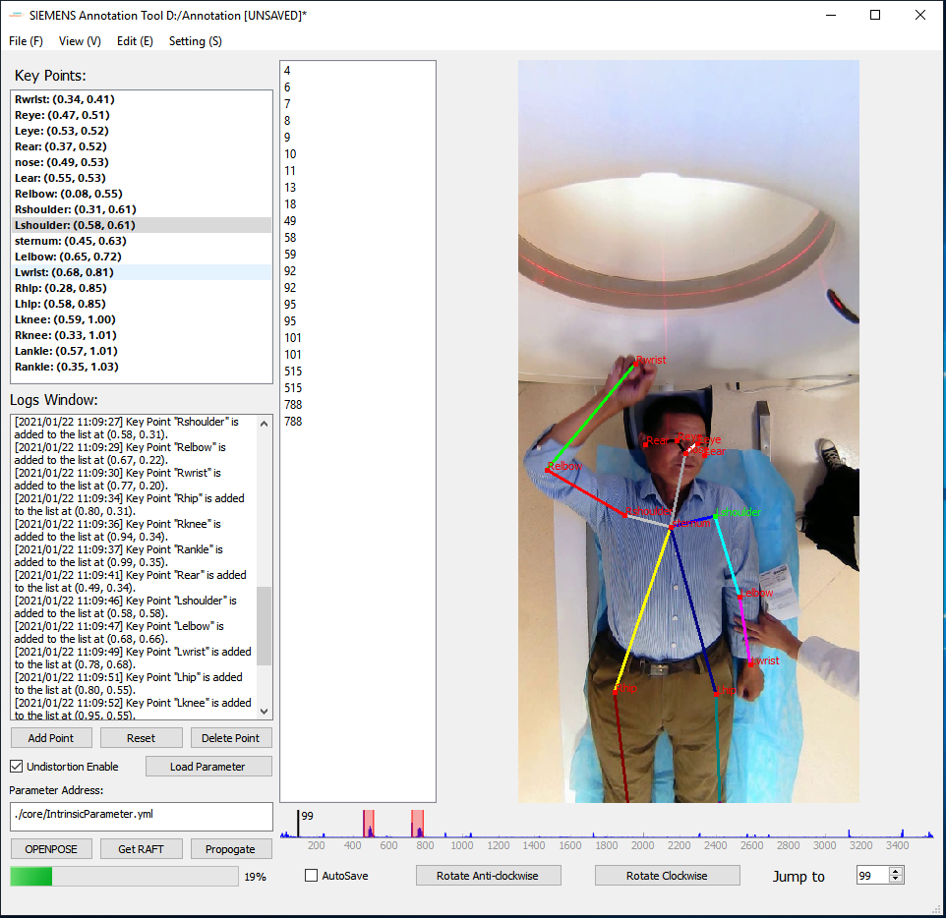
Encountered Problems
Inaccuracy in extreme local movement scenario

Slide 9
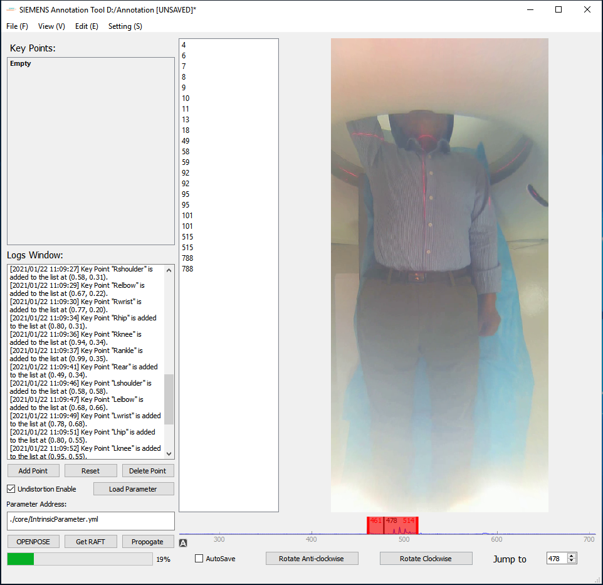
Encountered Problems
Inaccuracy in over-exposure scenario

Slide 10
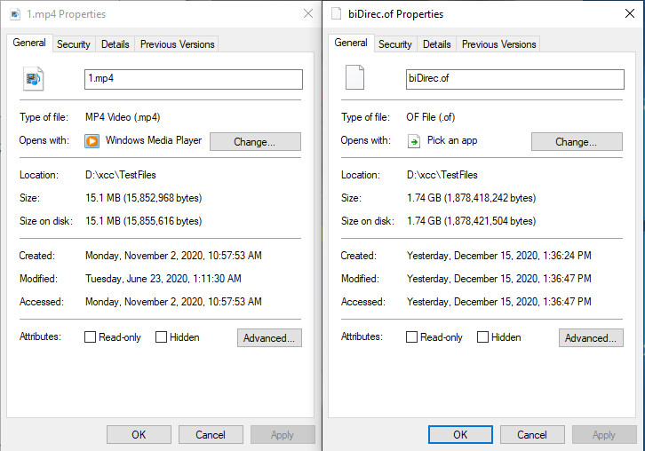
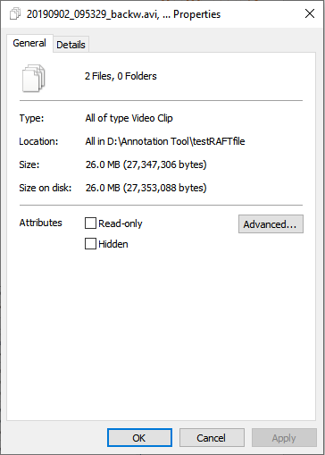
Encountered Problems
Unfeasible file size of optical flow result
15.1MB --> 1.74GB
ffmpeg encoding: 26.0MB as *.avi file

Slide 11
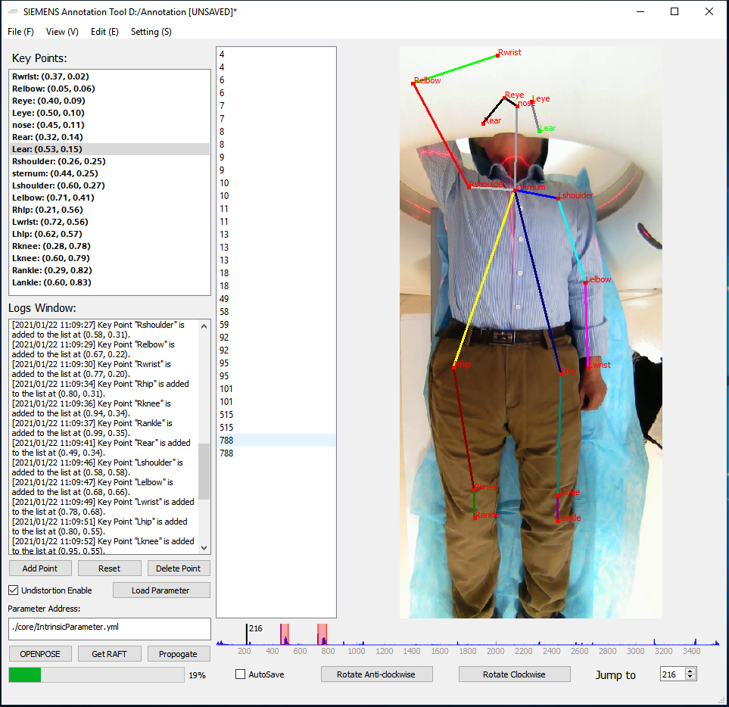
Encountered Problems
Lost view of key points

Slide 12
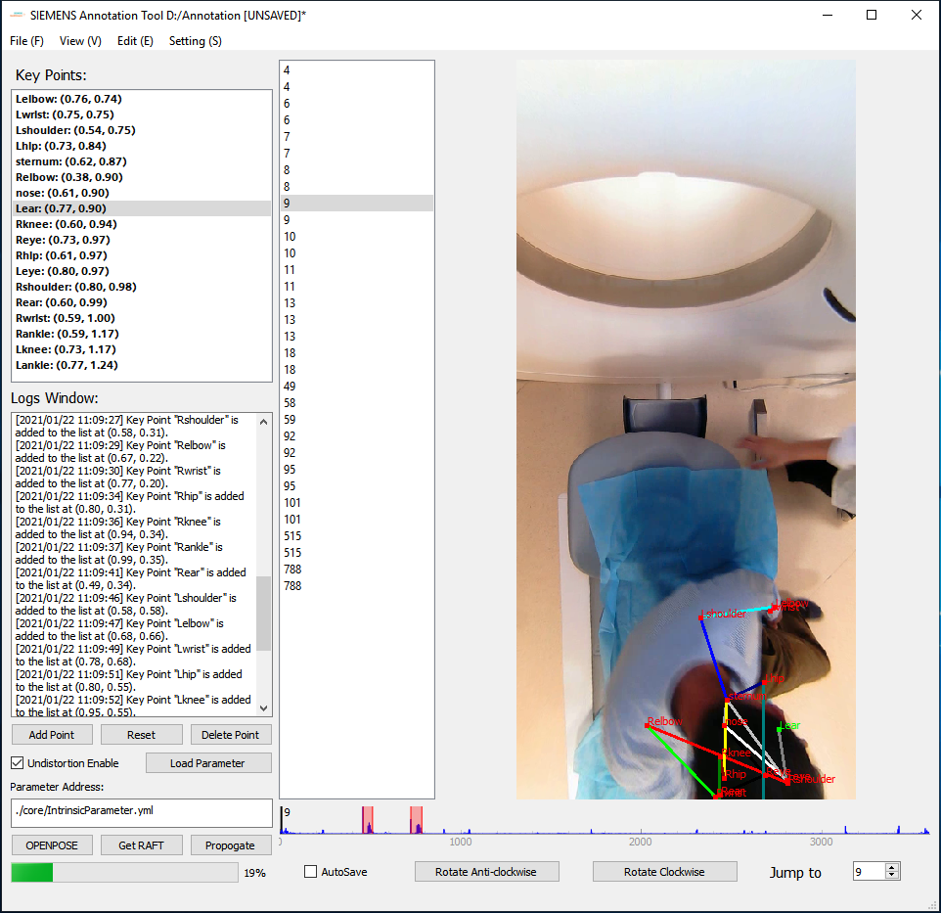
Encountered Problems
Special scenarios

